Slide 1

C-IPC
Inter Process Communication
By Justin Seda, Kevin Krause
Information from Professor Devito, Alex Keskinev - c language 2 PowerPoint Presentation, geeksforgeeks, etc

Slide 2
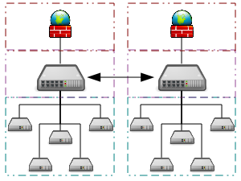
Inter Process Communication
Inter Process Communication is a mechanism that allows processes (programs) to transfer data to each other.
An example would be a Web browser requesting a page from a Web server. The Web browser send the server HTML data.

Slide 3

Types of Communication
Single System-takes place on one machine with multiple programs running
Network-takes place in at least 2 machines that are connected through the internet

Slide 4
C-IPC “Catalogs”
IPC use some of these mechanisms which allows processes to communicate with one another.
Forks
Pipes
Signals
Shared Memory
Message Queues
Sockets
Semaphores

Slide 5
Forks
A fork is a call in the program that creates a new process, called the child process.
The fork starts the main process which is called the parent process then the parent forks/starts the child process.
The child process is an exact copy of it’s parent and runs in parallel to the parent.
If the making of a child was unsuccessful, the the fork will return a negative number.
If it was successful then it will return a zero.
The parent returns a positive value.

Slide 6
Forks Example
#include<stdio.h>
#include <unistd.h>
int main()
{
fork();
printf("Hello world!\n");
return 0;
}
The output:
Hello World
Hello World

Slide 7
Forks Example
#include<stdio.h>
#include <unistd.h>
int main()
{
fork();
fork();
fork();
printf("Hello\n");
return 0;
}
The output:
Hello
Hello
Hello
Hello
Hello
Hello
Hello
Hello

Slide 8
This is how Fork works
#include<stdio.h> #include <unistd.h> int main() {
fork(); fork();
fork();
printf("Hello\n"); return 0; }
The output:
C
P
C
C
Hello
Hello
Hello
Hello
Hello
Hello
Hello
Hello
C
C
C
C

Slide 9
The amount of times a process will be done is given by the formula of 2^n. So if a process has 3 forks then it will have 8 processes.
Parent //parent process
|
F1 // The first fork will create one child process / \ F2 F2 // The second fork will create 2 child processes / \ / \ F3 F3 F3 F3 // Then the third fork will create 4 child processes

Slide 10
Now try this
Create a program that prints out the parent’s process id then the child process id. Use fork() and if statements while making your program. The answer will be on the next slide.

Slide 11
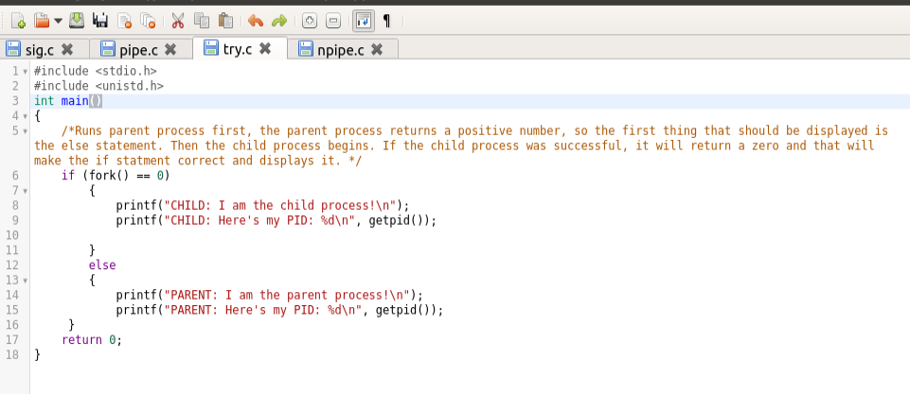
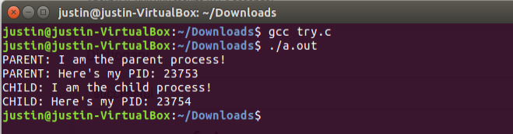
Answer

Slide 12
Now try this
Write a program that adds and sum in both the child and parent process.
The answer will be on the next slide.

Slide 13
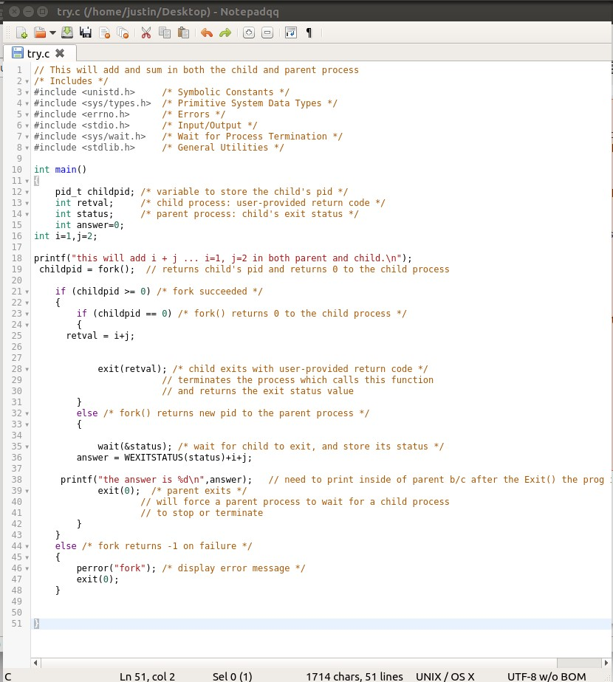
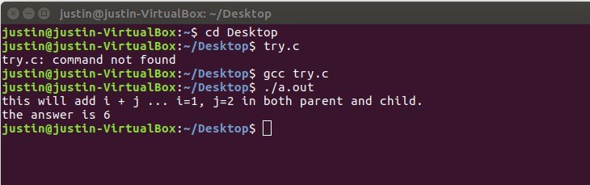
Answer

Slide 14

Pipes
Basically how a pipe works is that data that’s an output in one process becomes an input for another process. It communicates to both processes.
You can connect a fork to a pipe so the processes created by the fork can communicate. The parent process writes into the pipe then the child reads from the pipe.
Notes:
I need to look back at the italic part

Slide 15
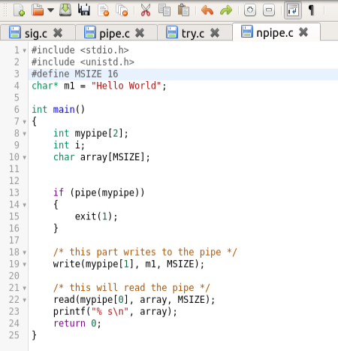
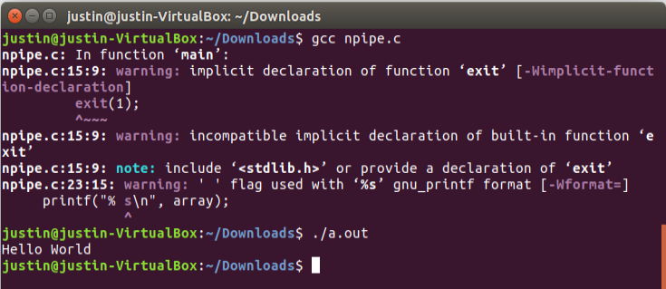
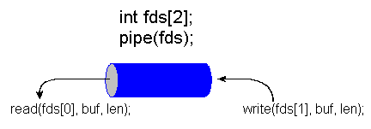
Pipe Example

Slide 16
Now try this
Write a program that writes in 3 separate messages into the pipe. After that, reads from the pipe and prints all the 3 messages.
The answer will be on the next slide.

Slide 17
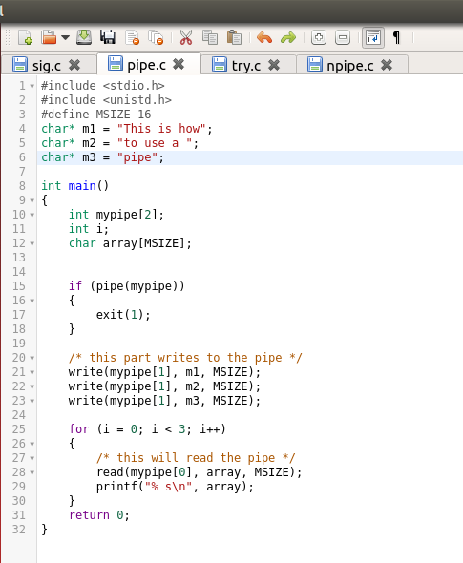
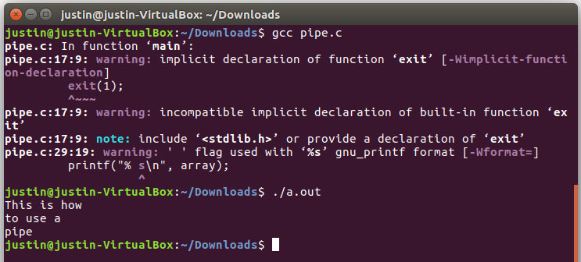
Answer

Slide 18
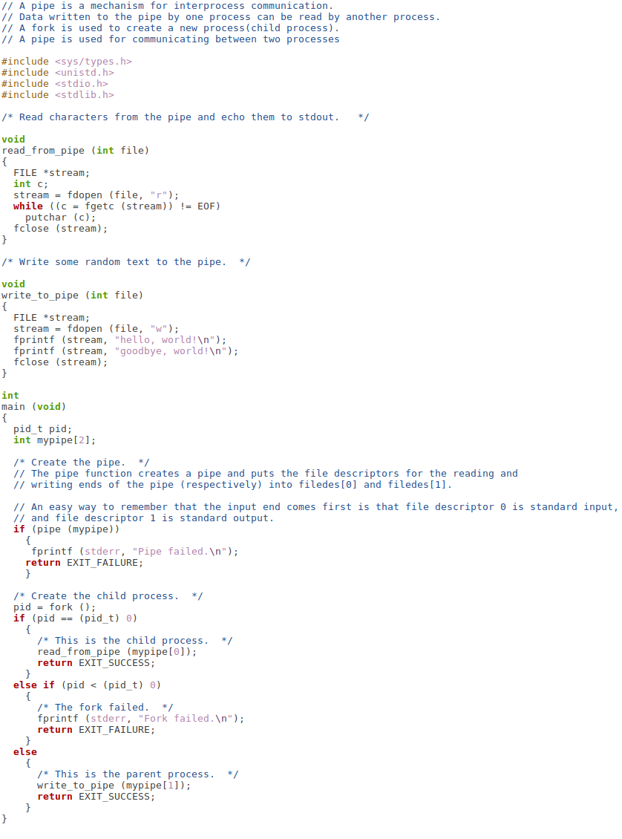
Forks and Pipes Example

Slide 19
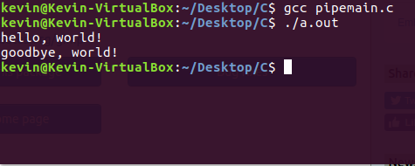
Forks and Pipes Output

Slide 20
Remember when doing a Fork and Pipe program that...
< 0 means that the fork failed to create a child process.
= 0 means that the fork was successful in creating a child process.
Notes:
<0 fail to create child (new) process
=0 for child process
>0 i.e process ID of the child process to the parent process. When >0 parent process will execute.

Slide 21
Now try this
Make a program that writes Hello world into a pipe when the child process equals zero and reads the pipe if it doesn’t.
The answer will be on the next slide.
Hint: Look at the fork slides and pipe slides.

Slide 22
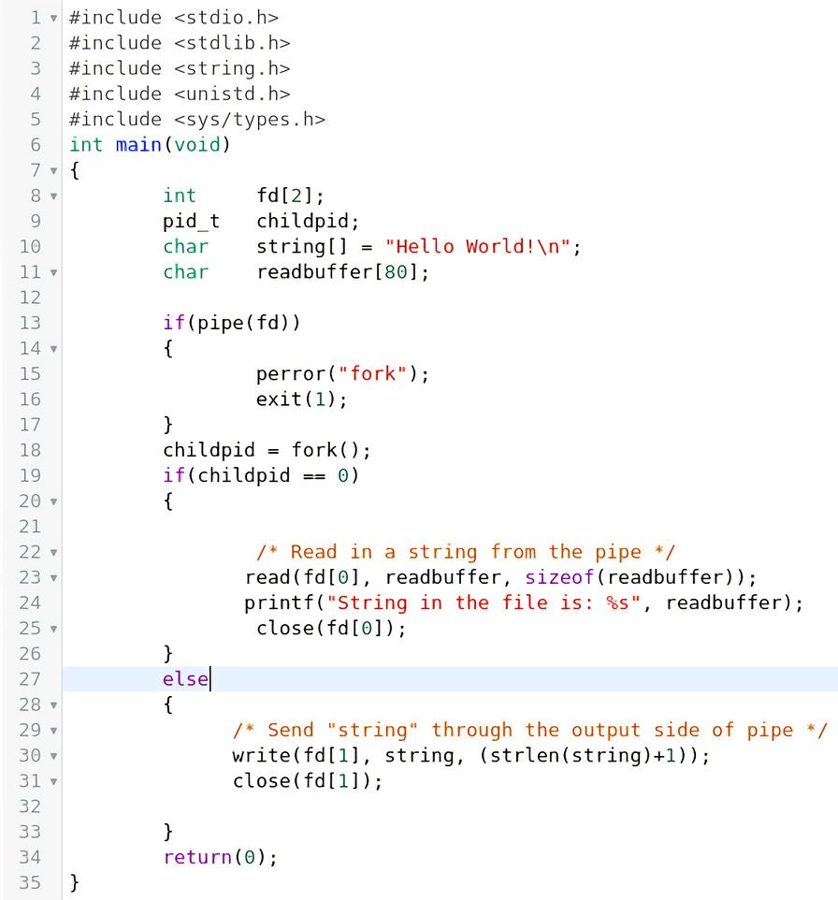
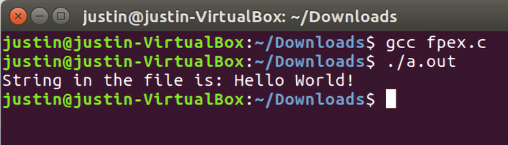
Answer

Slide 23
Signals
A signal is a software interrupt made by the OS.
When using signals, you must put include<signal.h> into your program.
To handle a signal, you must declare a signal() call which is
signal(type of signal you wish to use, the function the signal will go to)

Slide 24
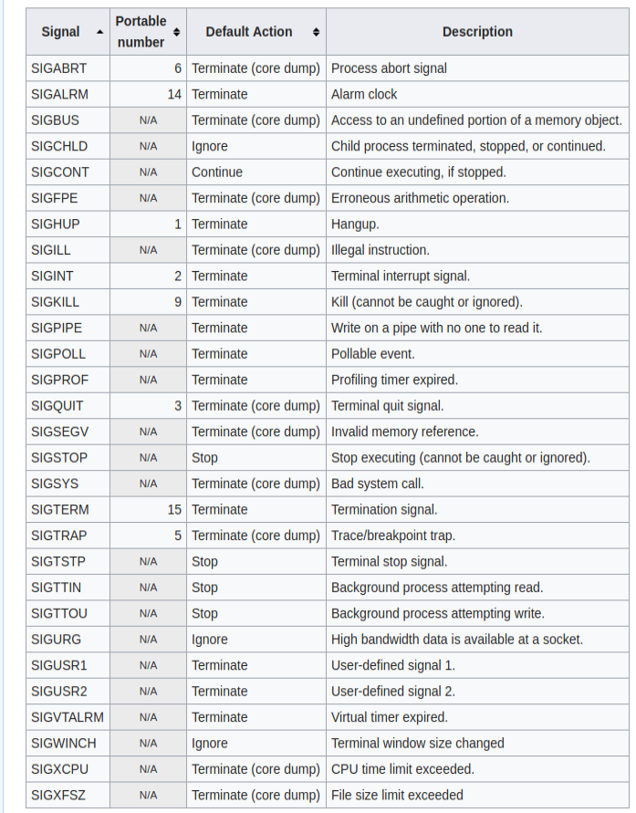
Here are the types of signals
that can be handled:

Slide 25
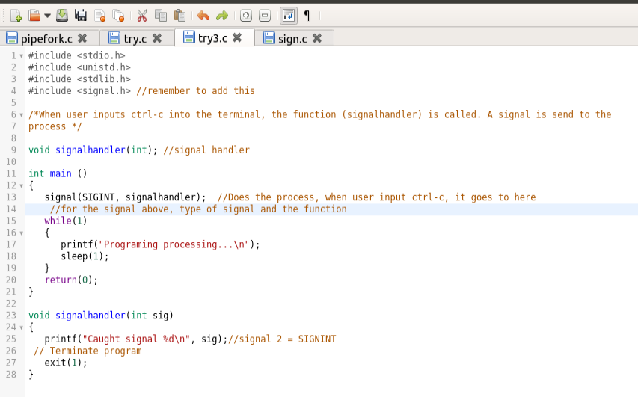
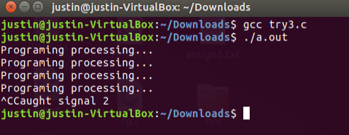
Signals Example
Notes:
https://users.cs.cf.ac.uk/Dave.Marshall/C/node24.html

Slide 26
Now try this
Create a signal handler for SIGCHLD signal.
SIGCHLD - Child process terminated, stopped, or continued
The answer will be on the next slide.

Slide 27
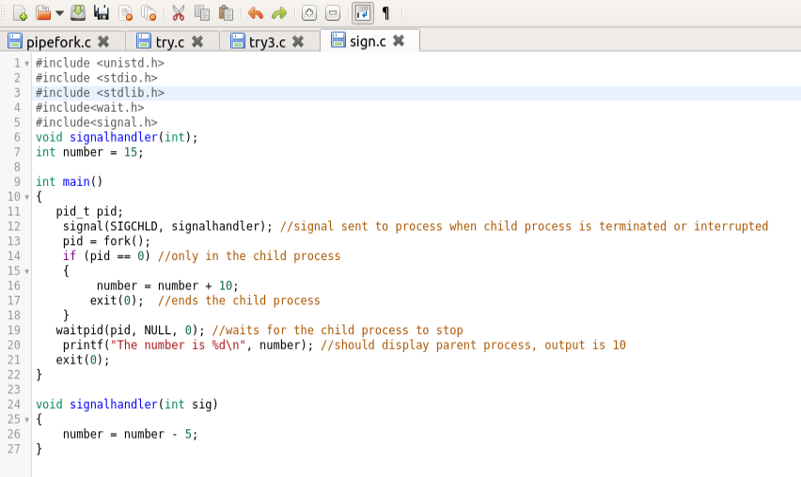
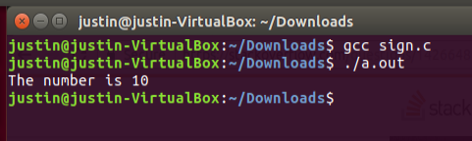
Answer
Notes:
https://users.cs.cf.ac.uk/Dave.Marshall/C/node24.html

Slide 28
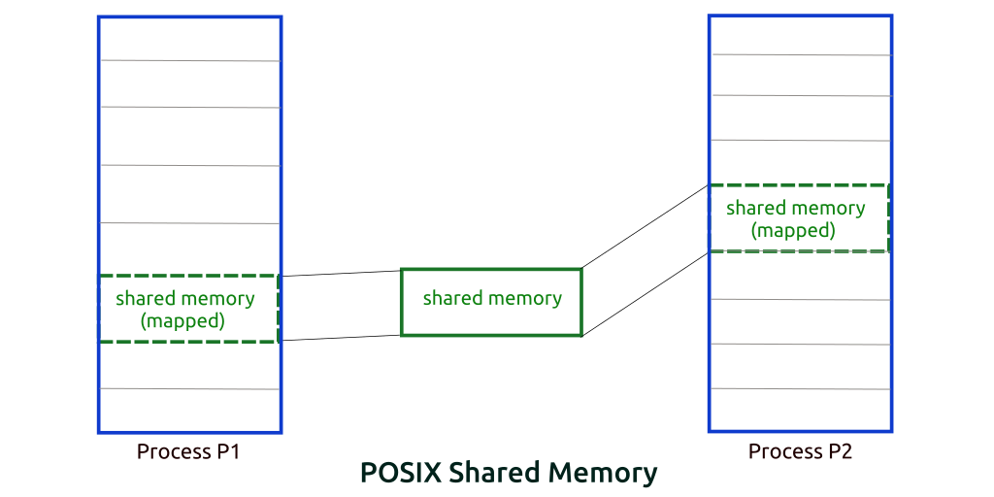
Shared Memory
shmget() is used to obtain access to a shared memory segment (give it a key and tell it how much shared memory you want), it will return the location of where that memory starts, then the process needs to attach itself to that shared memory They must both have the same key, in our example they both have the key 5678, you can make up the key, just so the processes that want to communicate use the same key

Slide 29
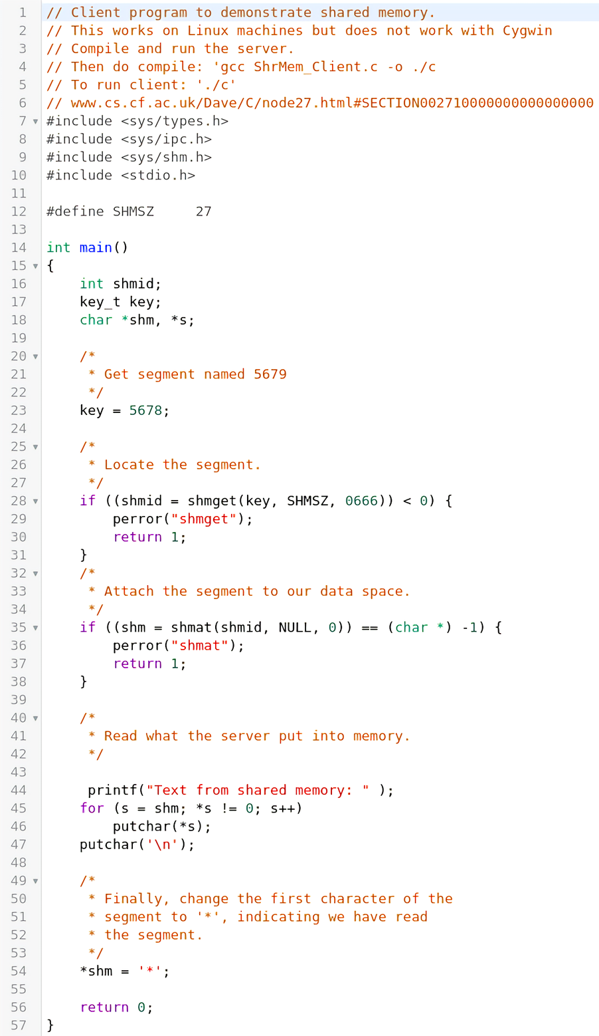
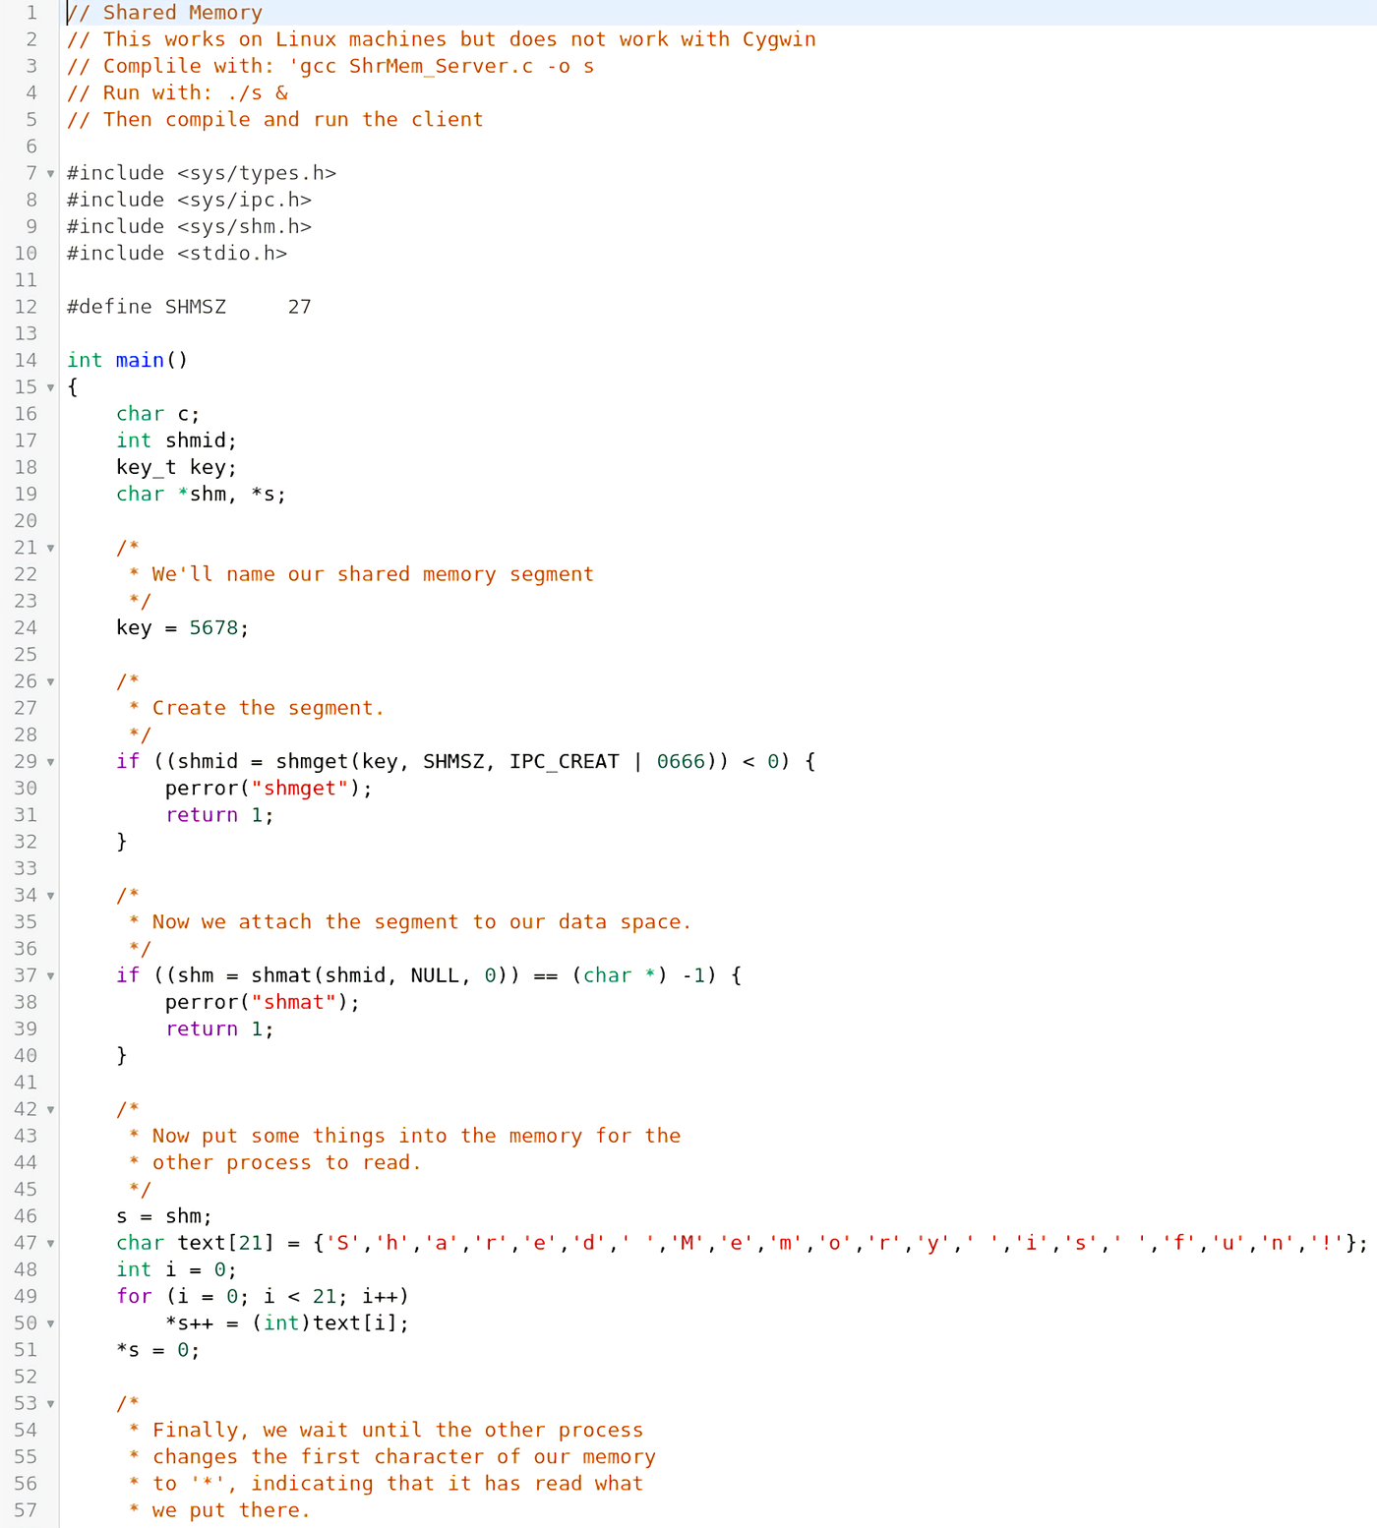
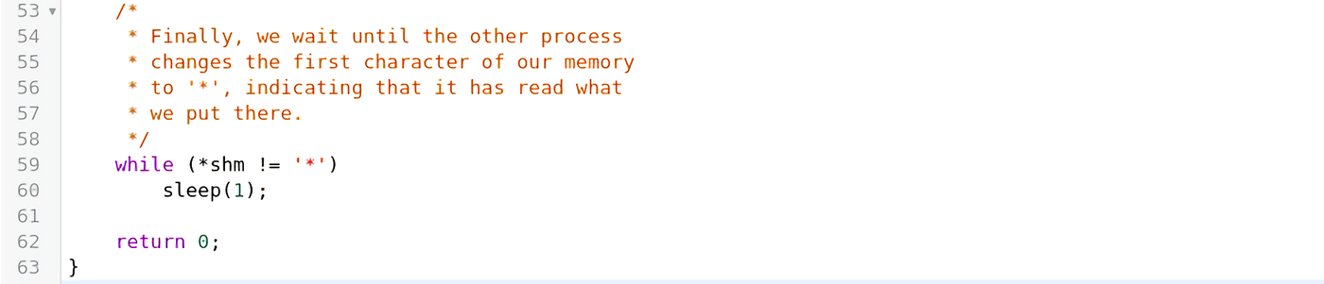
Shared Memory Example

Slide 30
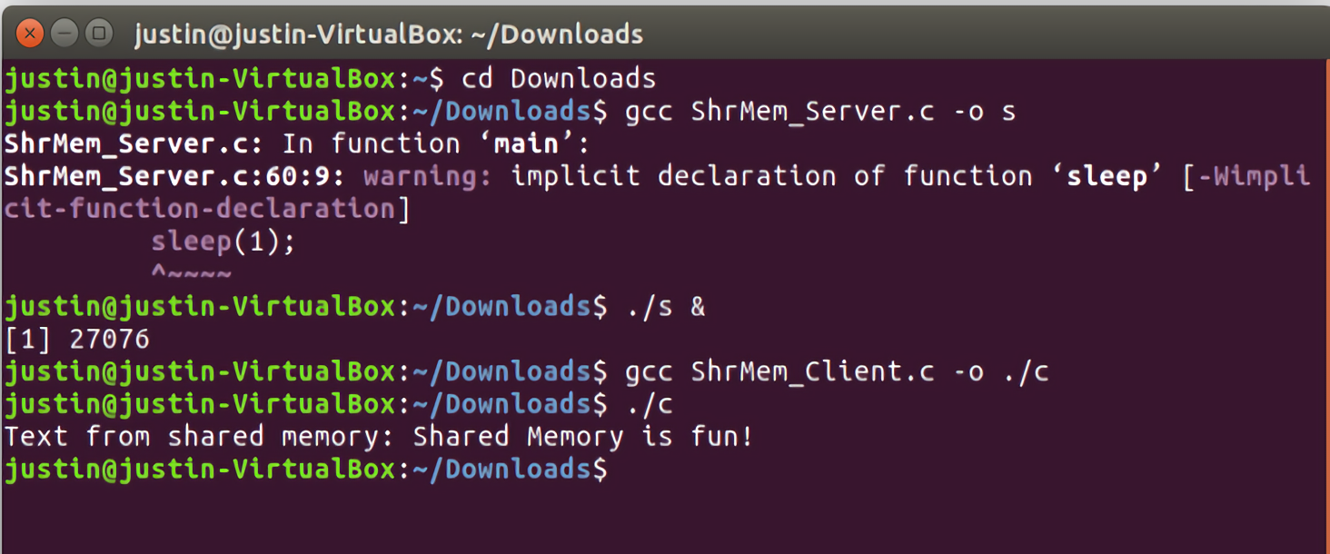
Shared Memory Output

Slide 31
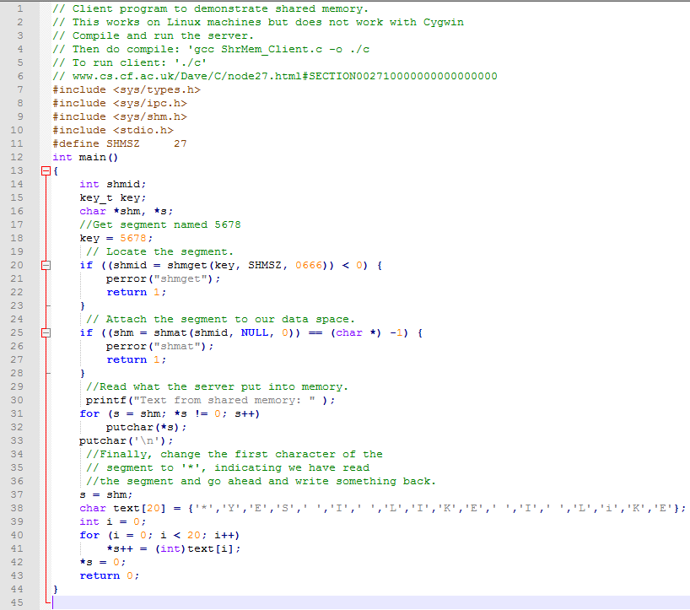
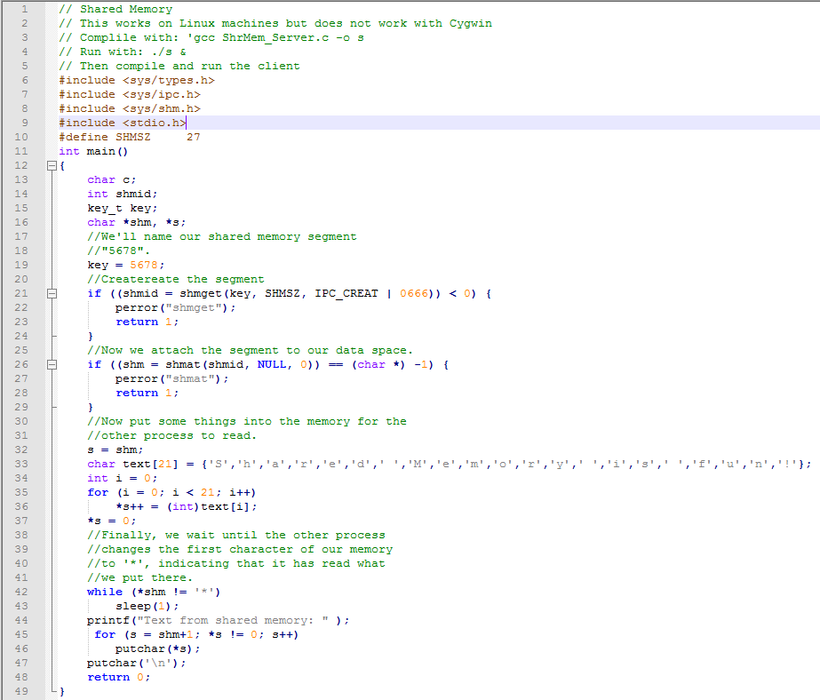
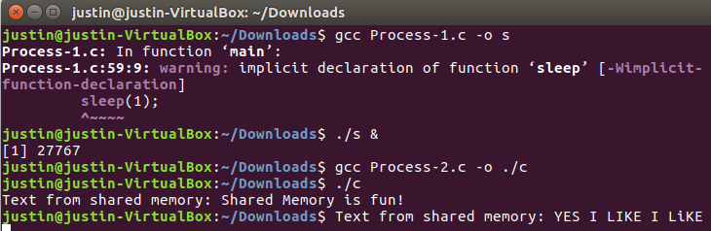
Process 1 and 2
Notes:
#include <sys/types.h>

Slide 32
Now try this
Play around with the programs for shared memory and try to create one of your own.

Slide 33
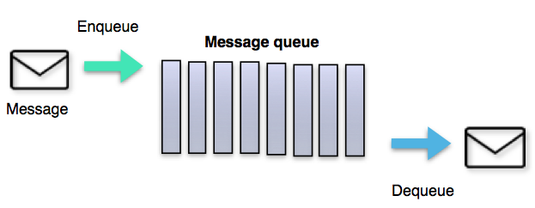
Message Queues
A message queue are functions that allows processes to swap information among each other.
There are two types of message queues…
msgsend() - this lets a process send a message.
msgrcv() - this lets a process receive a message.
Notes:
Hint

Slide 34
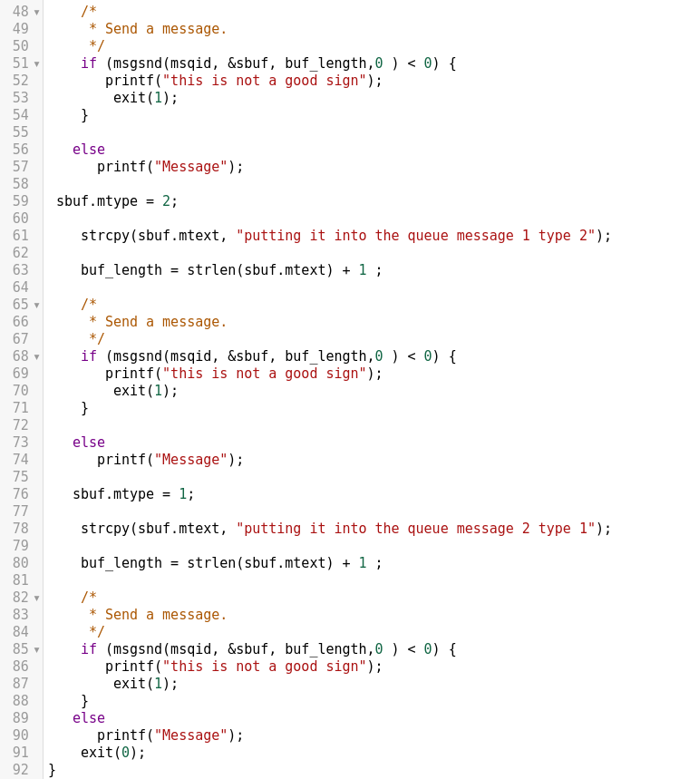
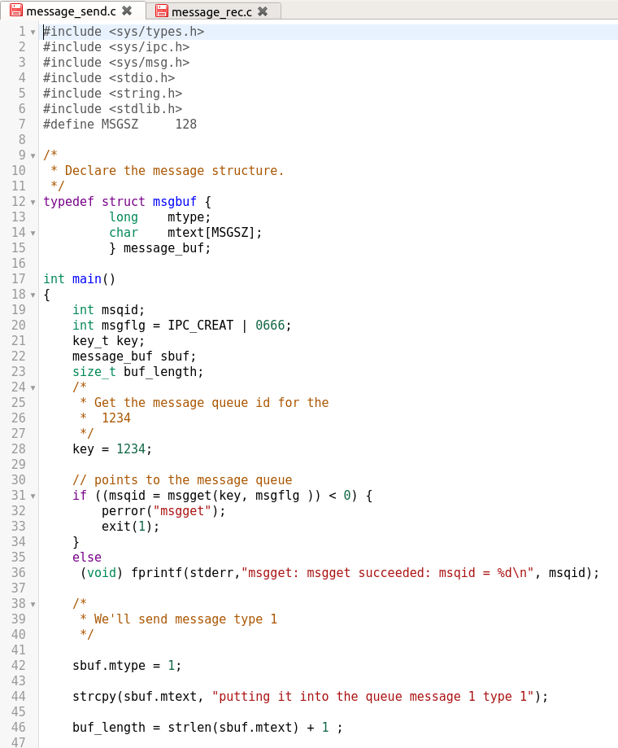
Message Queue Example
Message Send

Slide 35
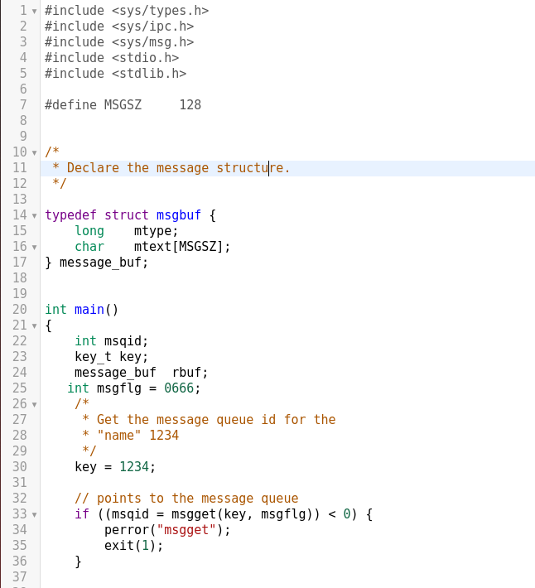
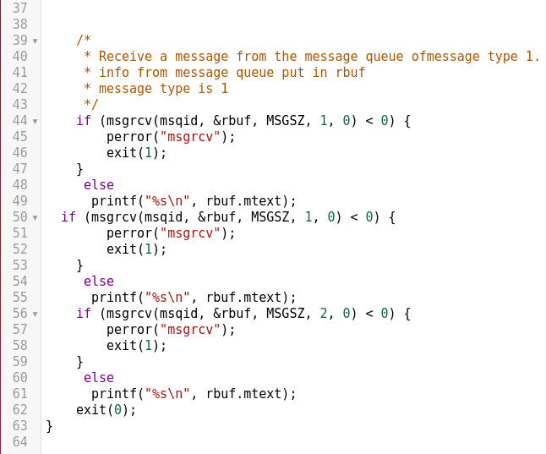
Message Received

Slide 36
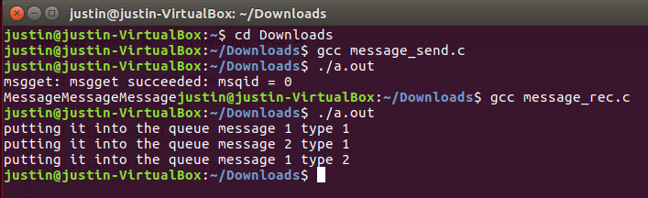
Message Queue Output
https://users.cs.cf.ac.uk/Dave.Marshall/C/node25.html

Slide 37
Now try this
Write a program that ask for the user to input a string and sends the message. Then create a program that receives that message.
The answer will be on the next slide.

Slide 38
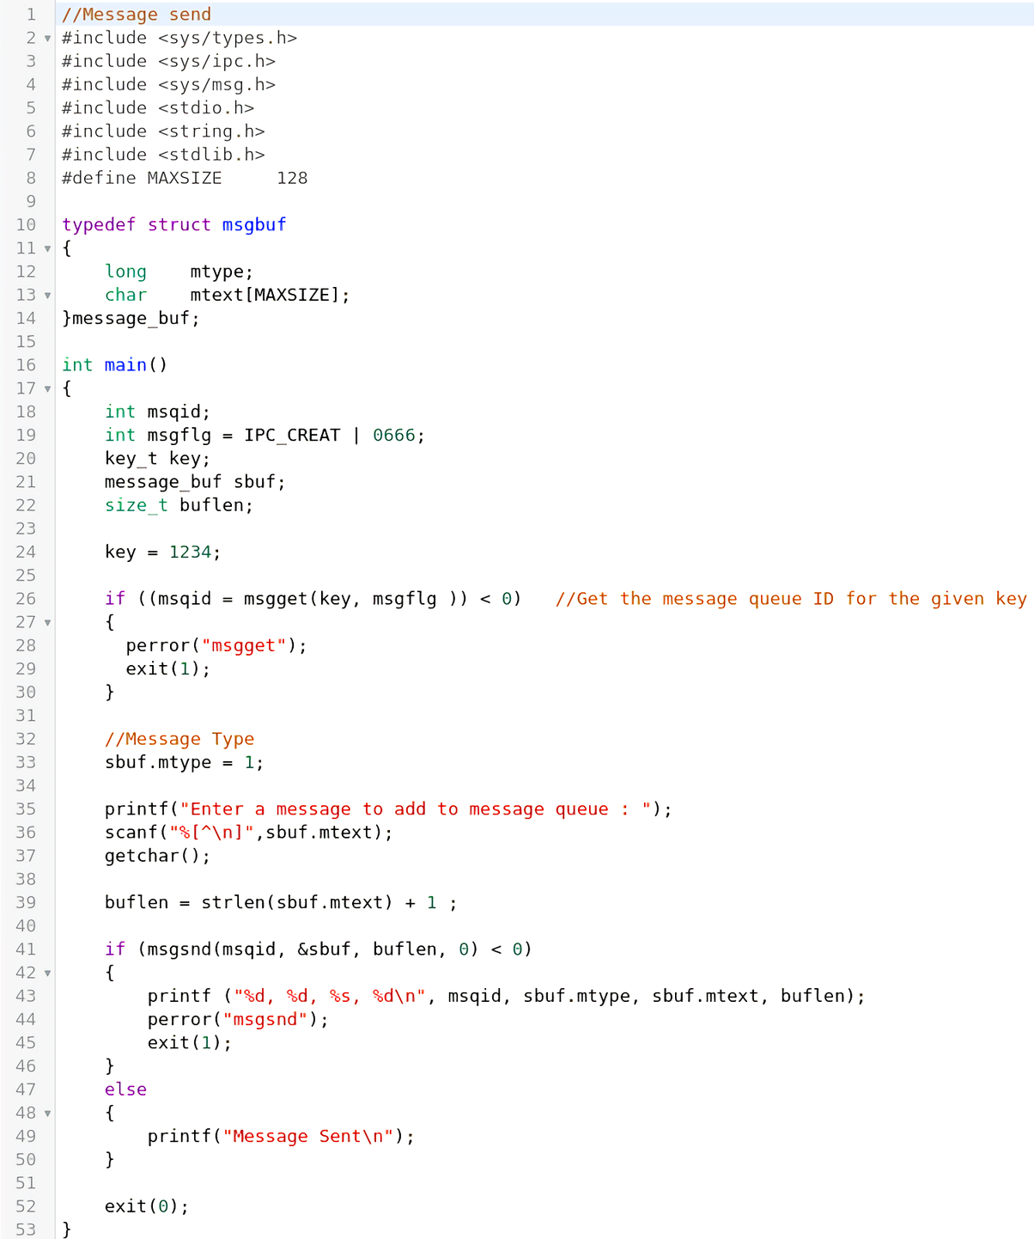
Message Send Answer

Slide 39
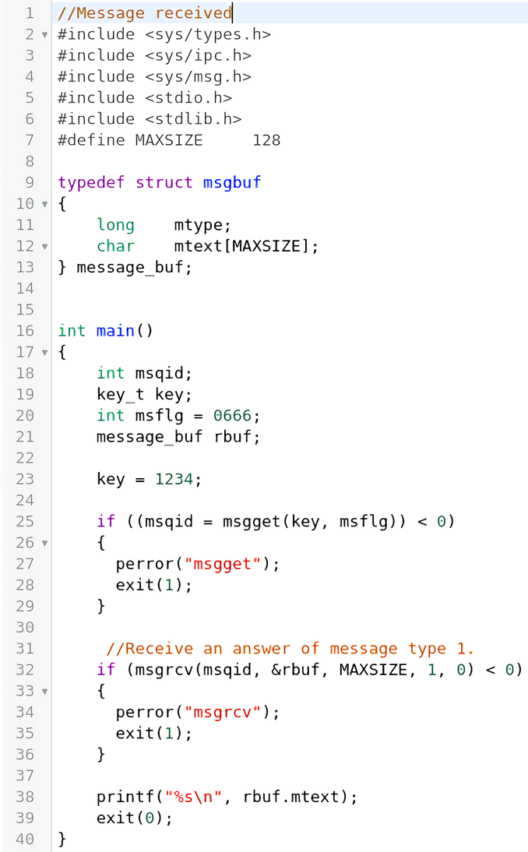
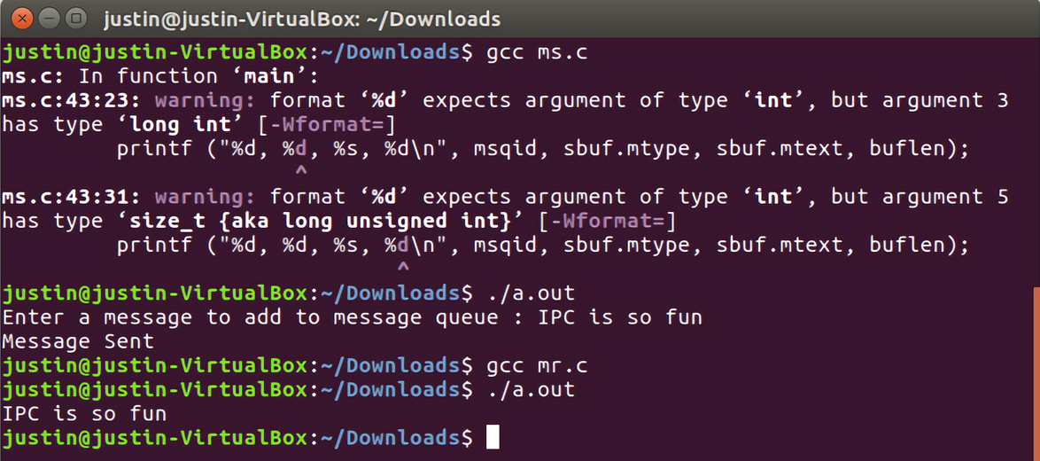
Message Received Answer
And Output

Slide 40
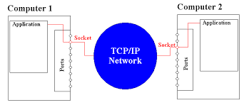
Sockets
A socket is one half of a two-way communication link between two programs on the network.
sockets are bound to port numbers that identify the data is sent to the location of the data.

Slide 41
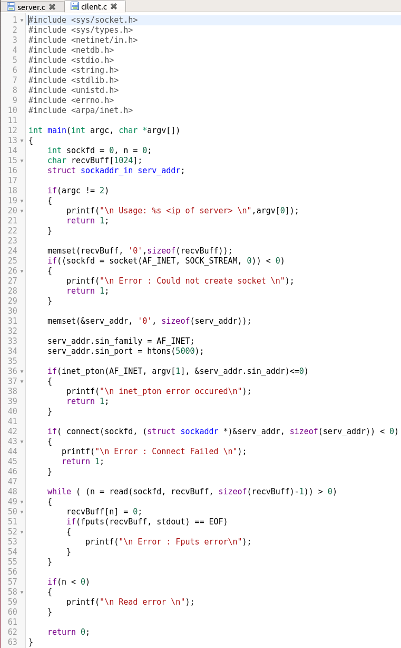
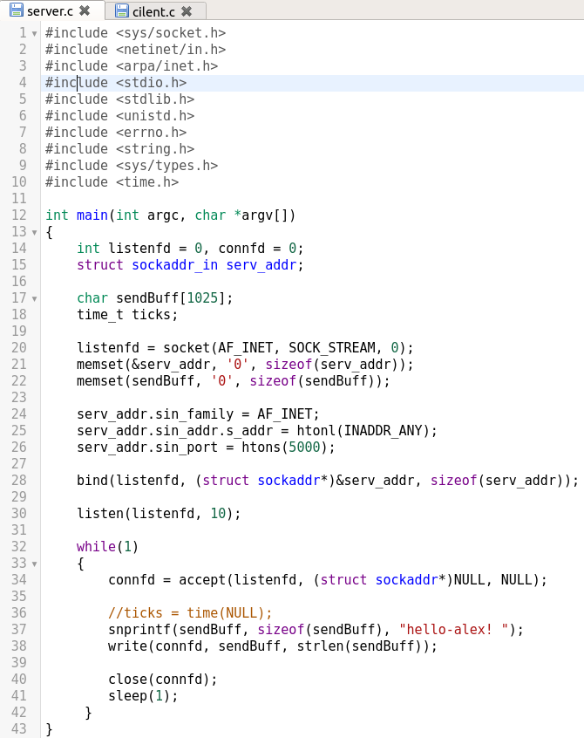
Sockets Example

Slide 42
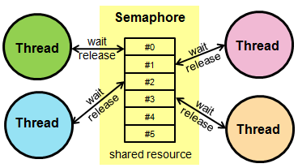
Semaphores
Simply put a semaphore is a variable.
“They are used to solve critical section problem and
to achieve process synchronization in the multi processing
Environment.” - http://www.geeksforgeeks.org
There are two types of semaphores - counting and binary.
Binary is self explanatory while counting is a non negative integer.
These variables are used for syncing in a processing environment and are very critical.

Slide 43
Semaphores
Semaphores are initialized and accessed through 2 atomic operations called P and V.
“P is also called wait, sleep and down operations
V is also called signal, wake-up and up operations”
- geeksforgeeks

Slide 44
Semaphores Example 1
Show codes that implement a pizza shop with a baker and a delivery guy. Assume that they cannot access the pizza cart with 5 shelves at the same time. Show your codes with semaphores

Slide 45
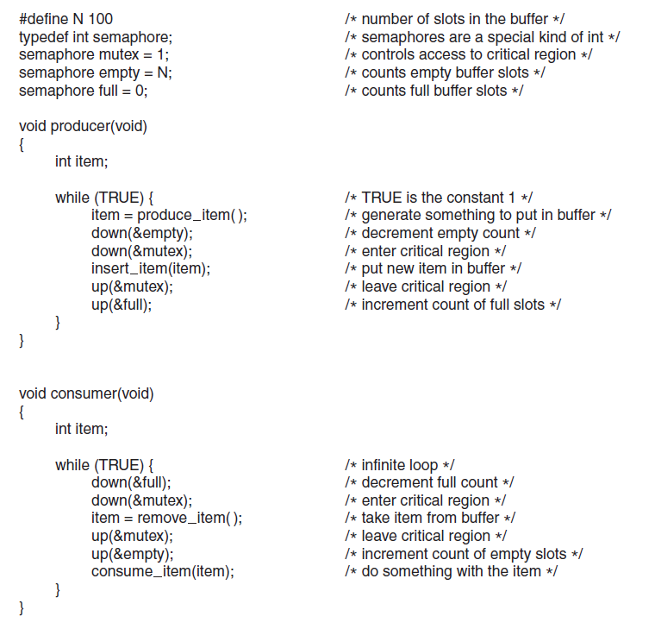
Semaphores Example 1

Slide 46
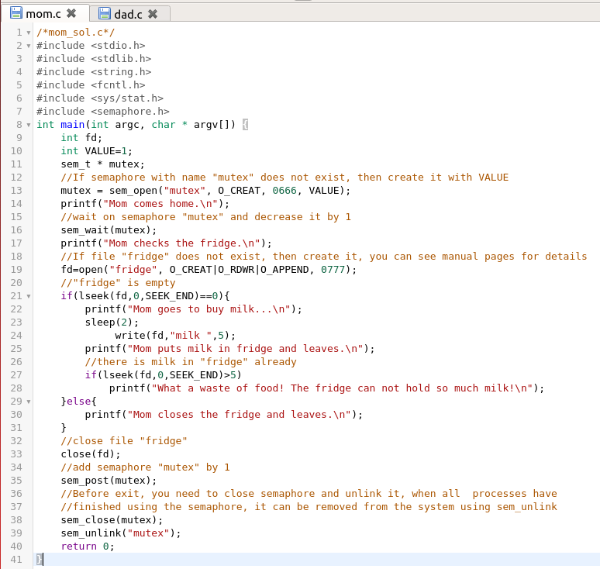
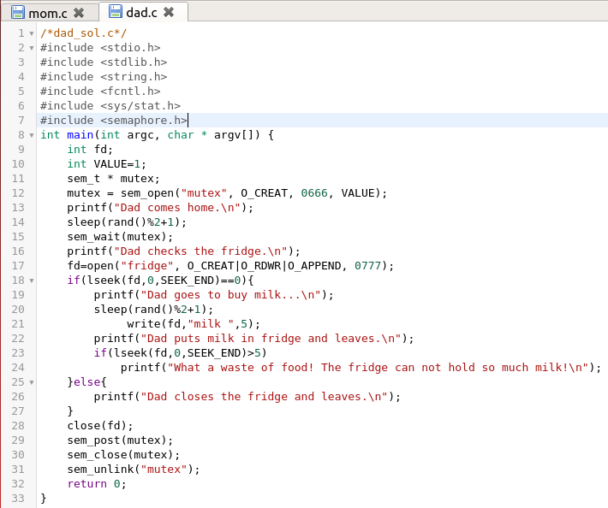
Semaphores Example 2

Slide 47
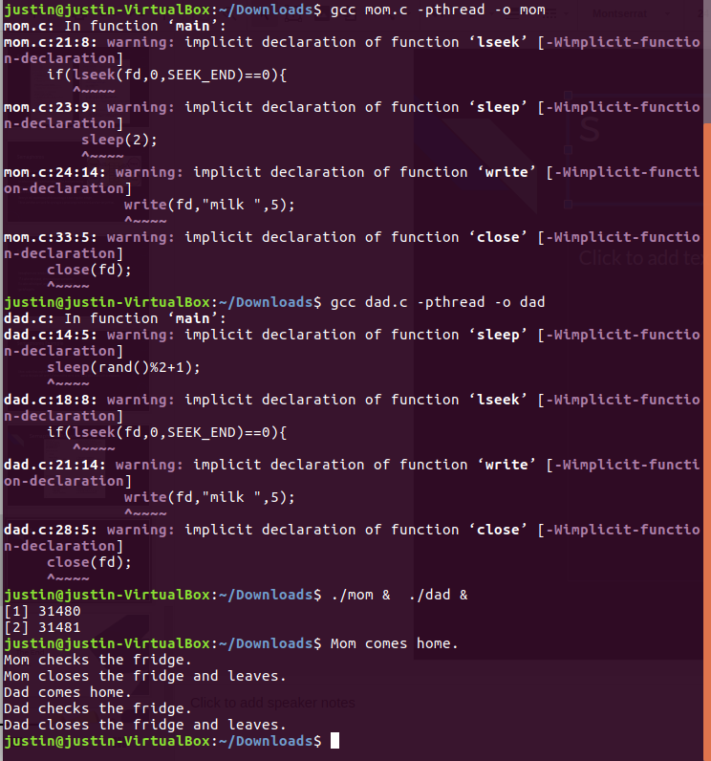
Semaphores Output
http://www.cse.cuhk.edu.hk/~ericlo/teaching/os/lab/7-IPC2/solution.html

Slide 48

The End
Of C-IPC
Notes:
We’ll make the ending better lol

